Slide 1
The Association Between Shift Work, Sleep Quality, and Health-Related Quality of Life Among Logistics Workers
Yongbo Xia
2255161

Slide 2
OUTLINE
Introduction
Method
Result
Discussion

Slide 3
INTRODUCTION
Background
Development of logistics industry.
Research Gap
Night shift work and physical and mental health of logistics workers.
Aims:
Night shift work and the decreased in physical and mental Health-Related Quality of Life among logistics workers
Certain sleep characteristics play as a mediator.

Slide 4
METHOD
Research type:
Cross- sectional study
Sample method:
Use online survey platform
Target population:
All logistics wokers who at least 18 years old in China.
Sample population:
484 participants

Slide 5
METHOD
Main exposures:
The stage of shift work
The years of night shift
The frequency of night shifts
Health-Related Quality of Life:
The Chinese version of the 12-Item Short Form Health Survey (SF-12)
Physical Component Summary (PCS) and Mental Component Summary (MCS)

Slide 6
METHOD
Sleep Characteristics:
Sleep duration: Average daily regular sleep time
Nap duration: Average daily short period sleep time
Sleep quality: Measured by the Insomnia Severity Index (ISI)
Covariates:
MBI
Behavioral (Somking, Drinking)

Slide 7
RESULT
Descriptive statistics:
Shift Work
Males accounted for 58.9% of all participants
66.5% worked both day and night shifts
Only 6.2% night shift only .
 | Daytime only | Night shift only | Both daytime and night shift | Total
Male | 68 (51.5%) | 16 (53.3%) | 201 (62.4%) | 285 (58.9%)
Female | 64 (48.5%) | 14 (46.7%) | 121 (37.6%) | 199 (41.1%)
Total | 132 (27.3%) | 30 (6.2%) | 322 (66.5%) | 484

Slide 8
RESULT
Sleep Characteristics
Longest sleep duration: only night shift workers
Longest Nap duration: only daytime shift workers .
Poorest sleep quality: workers in night shifts
 | Daytime only | Night shift only | Both daytime and night shift | Total
Sleep duration, median (IQR) | 7.92 h (7.05 to 8.78) | 8.40 h (6.40 to 10.40) | 7.55 h (6.45 to 8.65) | 7.70 h (6.57 to 8.83)
Nap duration, median (IQR) | 0.58 h (0.35 to 0.82) | 0.57 h (0.35 to 0.78) | 0.57 h (0.33 to 0.80) | 0.57 h (0.33 to 0.80)
Sleep quality (ISI), mean (SD) | 6 (5.7) | 10 (5.1) | 10 (3.7) | 9 (5.3)

Slide 9
RESULT
Night Shift with Health-Related Quality of Life:
Before consider covariates:
Shift work
Both the highest PCS and MCS : workers of daytime shifts .
Night shift only workers has the lowest MCS scores
 | n (%) | Physical component, mean (SD) | Mental component, mean (SD)
Daytime shift only | 132 (27.3%) | 48.8 (7.8) | 47.9 (10.2)
Both daytime and night shifts | 322 (66.5%) | 47.0 (6.4) | 46.1 (9.2)
Night shift only | 30 (6.2%) | 46.8 (8.2) | 44.4 (9.0)
P value |  | 0.005 | 0.034

Slide 10
RESULT
Years of night shift
Frequency of night shift
In years and frequency of night shift, PCS and MCS scores have a decreasing trend

Slide 11
RESULT
After consider covariates:
Shit work
Both PCS and MCS scores decreased.
The trendency of PCS is significantly statistical.
 | regression coefficient PCS(95%CI) | regression coefficient MCS(95%CI)
Daytime shift only(reference group) | \ | \
Both daytime and night shifts | -1.42 (-3.03 to 0.18) <0 | -0.86 (-2.72 to 1.00)<0
Night shift only | -2.28 (-5.31 to 0.75) <0 | -3.13 (-6.63 to 0.37) <0
Statistics for trend | p=0.050 | p=0.098

Slide 12
RESULT
Years of night shift
Years of night shif showed no significant associations with health outcomes.
 | regression coefficient PCS(95%CI) | regression coefficient MCS(95%CI)
Permanent daytime( reference group) | \ | \
1–5 years | -1.40 (-3.15 to 0.35) | -1.62 (-3.64 to 0.40)
6-10 years | -1.78 (-3.72 to 0.16) | 0.10 (-2.14 to 0.34)
More than 10 years | -1.29 (-4.36 to 1.77) | -2.13 (-5.66 to 1.41)
Statistics for trend | P=0.111 | P=0.603

Slide 13
RESULT
Frequency of night shift
Health outcome has a significant decrease when working over 7 days night shifts per month.
PCS trend have statistical significance.
 | regression coefficient PCS(95%CI) | regression coefficient MCS(95%CI)
Permanent daytime(reference) | \ | \
1–6 days per month | 0.01 (-2.15 to 2.18) | -0.93 (-3.45 to 1.59)
7–12 days per month | -1.76 (-3.49 to -0.04) | -0.96 (-2.97 to 1.09)
More than 12 days per month | -2.62 (-4.79 to -0.46) | -1.68 (-4.20 to 0.84)
Statistics for trend | P=0.006 | P=0.197

Slide 14
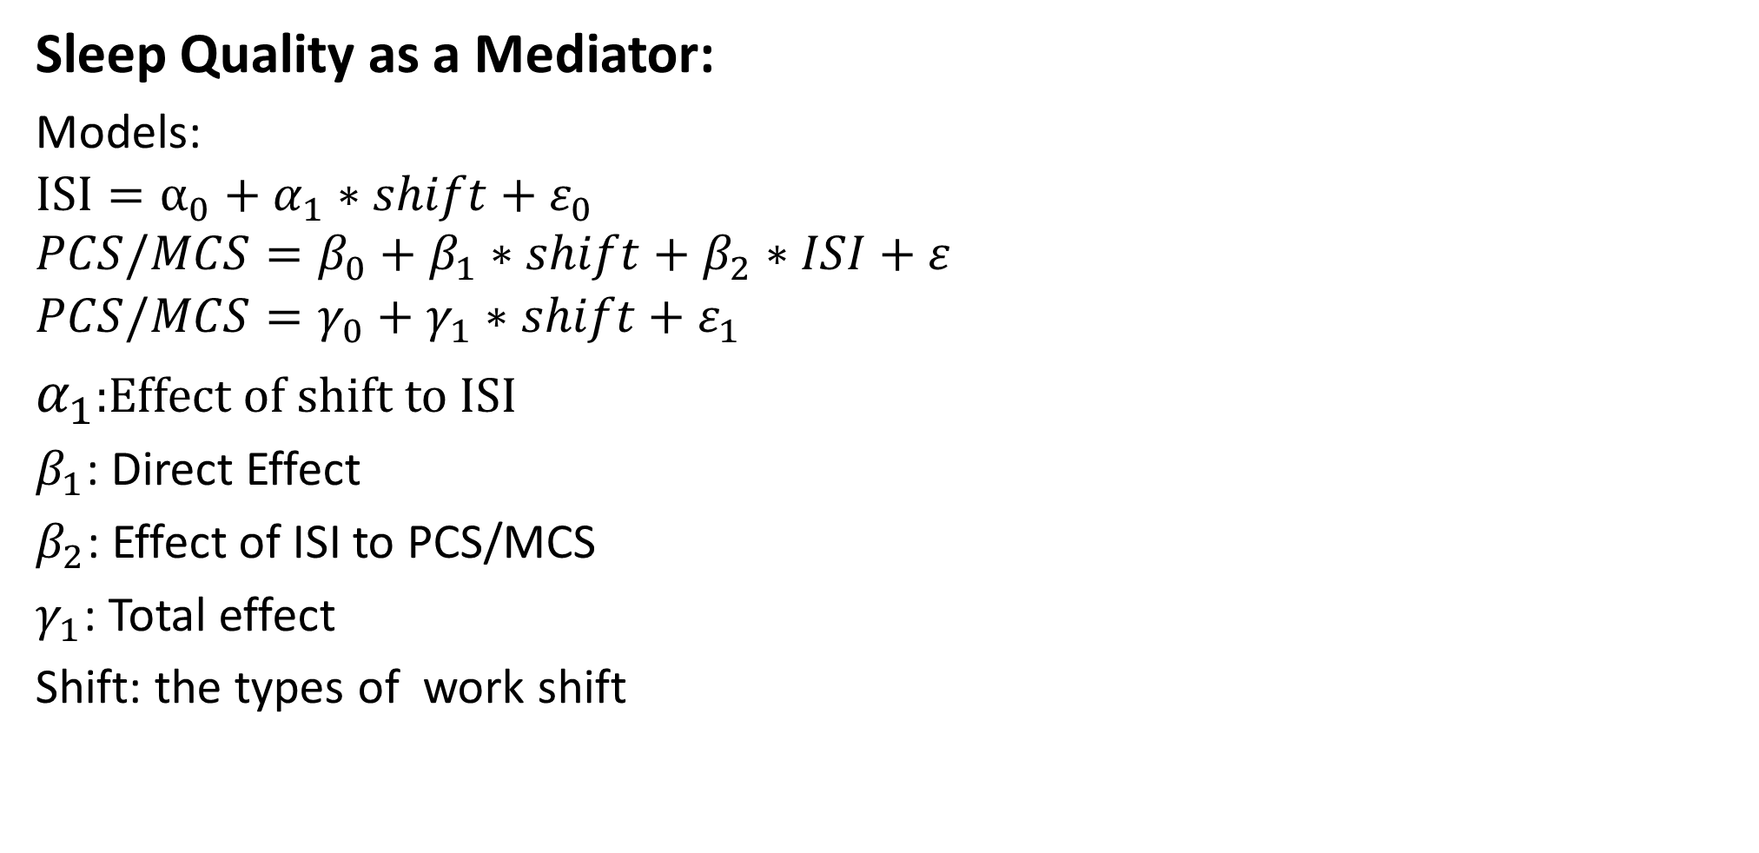
RESULT
Sleep Quality as a Mediator:
Models:
$$ISI=α_{0}+α_{1}∗shift+ε_{0} \\ PCS/MCS=β_{0}+β_{1}∗shift+β_{2}∗ISI+ε$$
$$PCS/MCS=γ_{0}+γ_{1}∗shift+ε_{1}$$
$α_{1}$:Effect of shift to ISI
$β_{1}$: Direct Effect
$β_{2}$: Effect of ISI to PCS/MCS
$γ_{1}$: Total effect
Shift: the types of work shift

Slide 15
RESULT
Sleep Quality as a Mediator:
PCS | Mediation effect (95% confidence interval), P value | Direct Effect（95% confidence interval), P value
Daytime shift only (reference ) | \ | \
Both daytime and night shifts | -1.23 (-2.18 to -0.31) , 0.004 | -0.08 (-1.34 to 1.20) , 0.928
Night shift only | -2.10 (-3.73 to -0.48) , 0.014 | -0.34 (-3.09 to 2.24) , 0.786
MCS | Mediation effect(95% confidence interval), P value | Direct Effect(95% confidence interval), P value
Daytime shift only(reference) | \ | \
Both daytime and night shifts | -1.17 (-2.13 to -0.28), 0.006 | 0.37 (-1.33 to 2.01), 0.662
Night shift only | -2.02 (-3.76 to -0.42), 0.022 | -0.88 (-3.95 to 2.28), 0.538

Slide 16
RESULT
Sleep Quality as a Mediator:
The PCS and MCS scores of both daytime and night shifts workers and working night shifts significant declines.
The direct effect not significant, mediation significant→Sleep quality (ISI) is the only way shift work affects health

Slide 17
DISCUSSION
Main Results:
Night shifts reduced the health-related quality of life in logistics workers.
The PCS and MCS scores of night shifts workers are lowest
A higher frequency of night shifts → significant deterioration in health status.
Sleep quality as a mediator
Advance:
Focus on the mental health of night shift workers
Promote the sleep quality of wokers

Slide 18
DISCUSSION
Adevantages:
Convenient and efficient
Sample range widely
Limatitions:
Small sample size (limited power)
Recall bias (self-reported data)
Reverse causality

Slide 19
Thank you for watching

